Slide 1

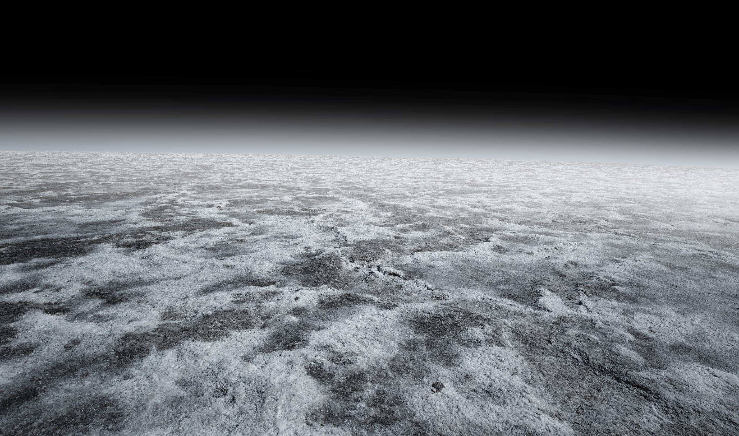

NGen Youth STEAM Activity
Lunar Mining Diorama:
Exploring Sustainable Resource Extraction
Youth Culture Inc. 2024 - All Rights Reserved

Slide 2
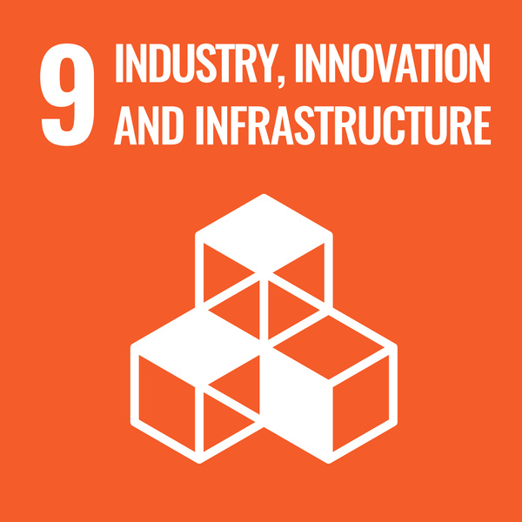
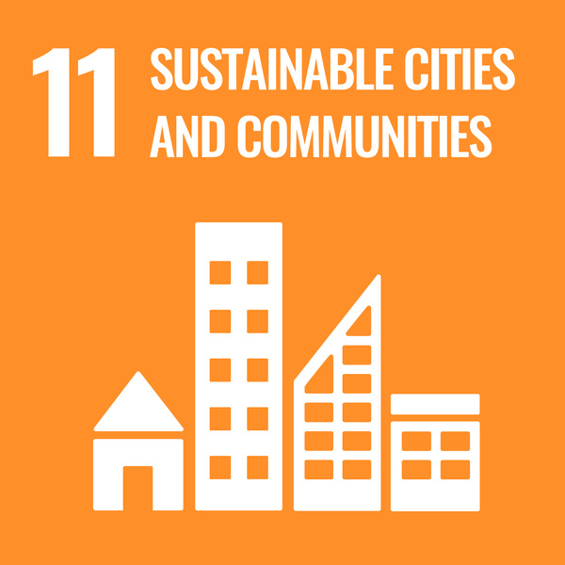
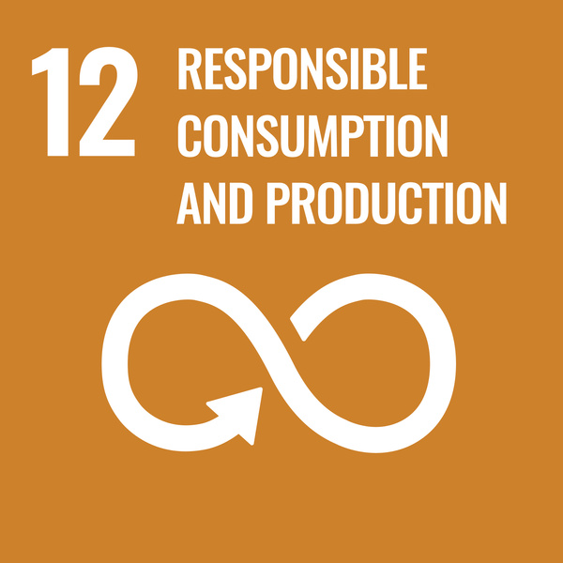
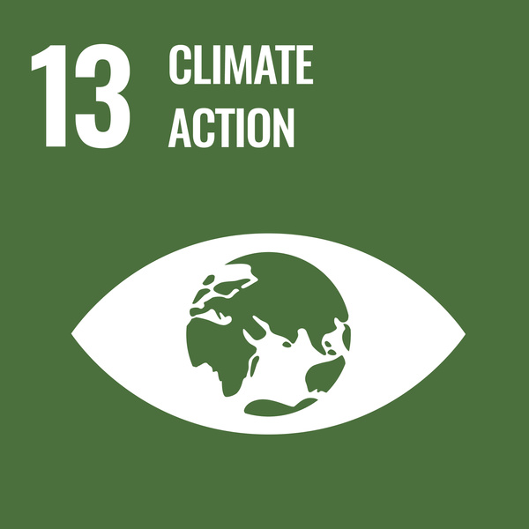
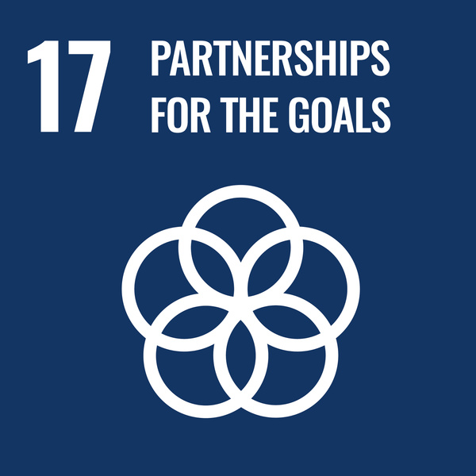
Sustainable Development Goals
Youth Culture Inc. 2024 - All Rights Reserved

Slide 3
Lunar Mining Diorama:
Exploring Sustainable Resource Extraction
Project Objective
To create a diorama that depicts a lunar mining operation and explores the concept of sustainable resource extraction on the Moon
Youth Culture Inc. 2024 - All Rights Reserved
Notes:
To create a diorama that depicts a lunar mining operation and explores the concept of sustainable resource extraction on the Moon, aligning with the Sustainable Development Goals (SDGs).

Slide 4


Lunar Mining Diorama:
Exploring Sustainable Resource Extraction
Learning Outcomes
  Gain understanding of lunar mining
  Develop research skills
  Develop creativity
  Foster critical thinking
  Promote awareness of sustainability
Youth Culture Inc. 2024 - All Rights Reserved
Notes:
- Gain understanding of lunar mining operations and the importance of sustainability
- Develop creativity and craftsmanship through diorama design and construction
- Foster critical thinking about the environmental impact of resource extraction on the Moon
- Promote awareness of global issues and encourage action towards achieving sustainable development goals through lunar mining endeavors

Slide 5
Lunar Mining Diorama:
Exploring Sustainable Resource Extraction
Materials Needed
  Access to research materials
  Small container for diorama
  Craft supplies
  Optional
    Small figurines or toy vehicles
    Modeling clay
    LED lights
Youth Culture Inc. 2024 - All Rights Reserved
Notes:
- Shoeboxes or other small containers for dioramas
- Craft supplies such as construction paper, markers, glue, scissors
- Small figurines or toy vehicles for lunar mining operation
- Modeling clay or playdough for creating lunar landscape
- Optional: LED lights for simulating lunar lighting effects

Slide 6
Lunar Mining Diorama:
Exploring Sustainable Resource Extraction
Project Outline
Part 1 - Class Discussion
Part 2 - Lunar Mining Research
Part 3 - Diorama Design
Part 4 - Showcase and Reflection
Youth Culture Inc. 2024 - All Rights Reserved

Slide 7
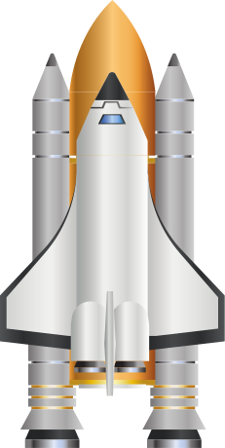

Let’s Get Started!
Part 1: Discussion
Youth Culture Inc. 2024 - All Rights Reserved
Notes:
Introduce students to the concept of lunar mining and the importance of sustainability in resource extraction. Introduce students to the idea that mining operations on the Moon must be conducted in a way that minimizes environmental impact and promotes long-term sustainability.

Slide 8

Discussion Question
What is resource extraction or mining?
Youth Culture Inc. 2024 - All Rights Reserved

Slide 9
Discussion Question
What are challenges involved in mining resources on Earth?
Youth Culture Inc. 2024 - All Rights Reserved

Slide 10
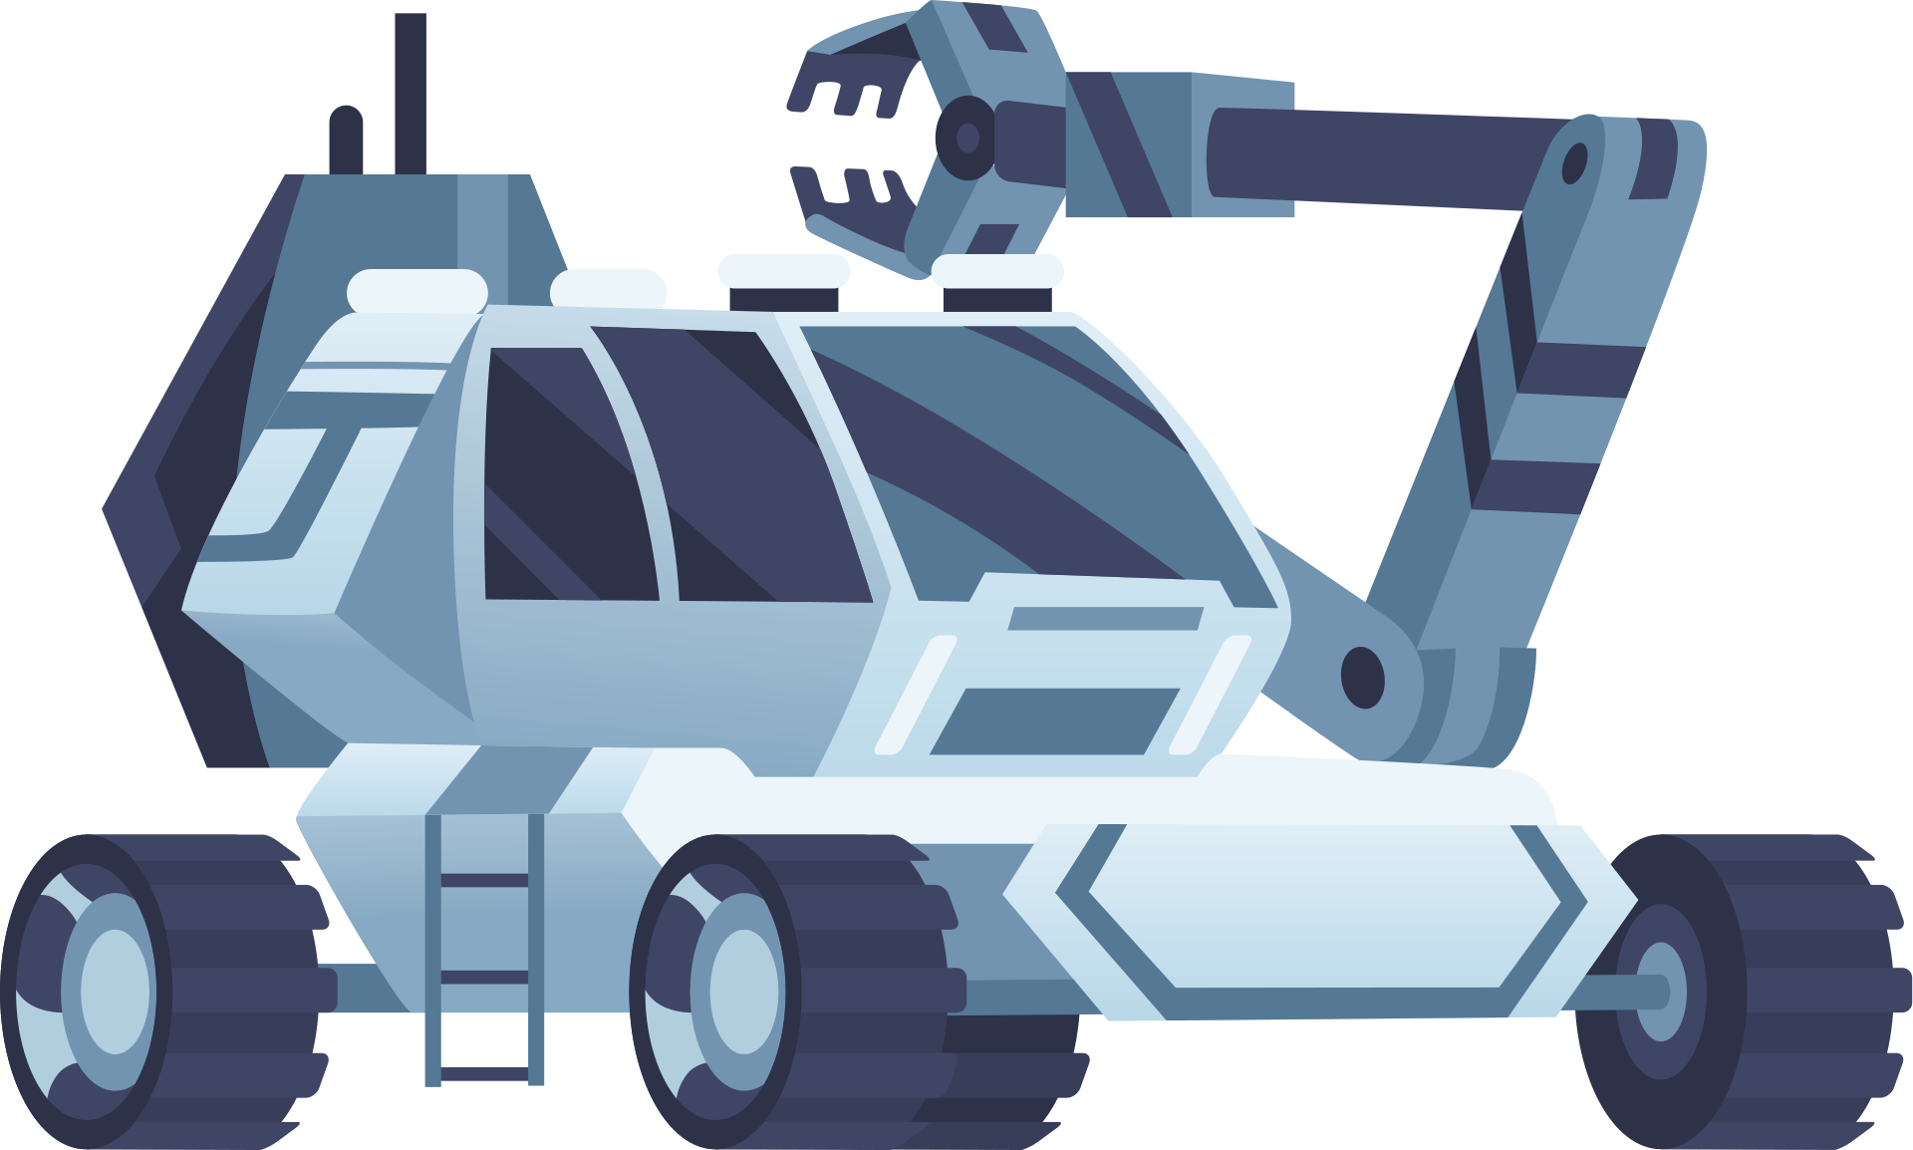
Discussion Question
Why is sustainability crucial in resource extraction?
Youth Culture Inc. 2024 - All Rights Reserved

Slide 11
Discussion Question
What comes to mind when you hear the term
"lunar mining"?
Youth Culture Inc. 2024 - All Rights Reserved

Slide 12
Discussion Question
How do you think lunar mining operations differ from mining practices on Earth?
Youth Culture Inc. 2024 - All Rights Reserved

Slide 13
Discussion Question
How can the lunar environment be preserved while mining for resources?
Youth Culture Inc. 2024 - All Rights Reserved

Slide 14
Discussion Question
What ethical considerations are there when planning lunar mining activities?
Youth Culture Inc. 2024 - All Rights Reserved

Slide 15
Discussion Question
How could lunar mining contribute to the advancements of technology and sustainability efforts?
Youth Culture Inc. 2024 - All Rights Reserved

Slide 16
Part 2: Research
Youth Culture Inc. 2024 - All Rights Reserved
Notes:
Assign students to research different aspects of lunar mining, including the types of resources that could be mined, potential extraction methods, and environmental considerations. Encourage students to think about how these mining operations could support sustainable development goals such as clean energy, economic growth, and environmental protection.

Slide 17
Research
Become an Expert!
Choose a Lunar Mining Research Topic to Focus on
Youth Culture Inc. 2024 - All Rights Reserved

Slide 18

Lunar Mining Research Topics
  Types of Lunar Resources
  Mining Methods
    Prospecting and exploration techniques
  What happens once you extract resources?
    Processing and Refining techniques
  Environmental considerations
  Sustainability practices
    Renewable energy
    Recycling and conservation
    Use of autonomous & robotic systems
  Technology
    Equipment & Machinery
    3D Printing & Additive Manufacturing for lunar construction
More Topics!
Youth Culture Inc. 2024 - All Rights Reserved

Slide 19
Lunar Mining Research Topics
  Legal Framework
    International agreements
    Ownership and property rights in space
  Ethical Implications
    Equitable distribution of resources
    Addressing concerns about space debris
  Scientific Research Opportunities
    Studying lunar geology
  Life on the Moon
    Lunar settlements
    Health and well-being
  Potential Benefits
    Supporting development of sustainable technologies
    Contributing to advancements in science, engineering, and space research
Youth Culture Inc. 2024 - All Rights Reserved

Slide 20
Research
What information did you find?
What needs to be further explored?
Youth Culture Inc. 2024 - All Rights Reserved

Slide 21
Research
Provide an overview of key concepts, theories, or research relevant to your topic
Youth Culture Inc. 2024 - All Rights Reserved

Slide 22
Research
Are there key concepts that are new to you?
Youth Culture Inc. 2024 - All Rights Reserved

Slide 23
Research
What conclusions can you draw from your research?
Youth Culture Inc. 2024 - All Rights Reserved

Slide 24
Part 3: Diorama Design
Youth Culture Inc. 2024 - All Rights Reserved
Notes:
Provide students with shoeboxes or small containers to serve as the base for their dioramas. Encourage them to use craft supplies and modeling materials to create a realistic lunar landscape, including craters, rocks, and lunar soil. Students can also design and construct miniature mining equipment, vehicles, and facilities to depict a sustainable mining operation on the Moon.

Slide 25
Diorama Design
Step 1: Choose a Focus
Youth Culture Inc. 2024 - All Rights Reserved

Slide 26
Diorama Design
Step 1: Choose a Focus
What aspect of Lunar Mining do you want to focus on?
Lunar habitat, lunar geology, mining operation, technologies, research station, etc.
Youth Culture Inc. 2024 - All Rights Reserved

Slide 27
Diorama Design
Step 2: Planning
Youth Culture Inc. 2024 - All Rights Reserved

Slide 28
Diorama Design
Step 2: Planning
Plan your diorama
Gather resources you can refer to (images, articles, videos)
What materials do you need?
Youth Culture Inc. 2024 - All Rights Reserved

Slide 29
Diorama Design
Step 2: Planning
Plan how you will showcase sustainable features or practices
Youth Culture Inc. 2024 - All Rights Reserved

Slide 30
Diorama Design
Step 3: Build!
Youth Culture Inc. 2024 - All Rights Reserved

Slide 31
Diorama Design
Step 3: Build
Let your creativity shine!
Youth Culture Inc. 2024 - All Rights Reserved

Slide 32
Diorama Design
Step 3: Build
What you can include:
  Surface of the moon
    Craters, rocks, boulders, minerals
Youth Culture Inc. 2024 - All Rights Reserved

Slide 33
Diorama Design
Step 3: Build
What you can include:
  Structures
    Lunar habitats, mining equipment, vehicles, research facilities, lunar rovers, spacecraft, solar panels, communication antennas, etc.
Youth Culture Inc. 2024 - All Rights Reserved

Slide 34
Part 4:
Showcase & Reflection
Youth Culture Inc. 2024 - All Rights Reserved
Notes:
Encourage students to consider how their dioramas can reflect sustainable practices in lunar mining. This could include incorporating renewable energy sources such as solar panels, implementing waste recycling systems, or designing habitats that minimize impact on the lunar environment. Students can use labels or captions to explain the sustainable features of their dioramas.
Have students present their dioramas to the class, explaining the elements they included and how they promote sustainability in lunar mining. Encourage peer feedback and discussion about the different approaches to sustainable resource extraction depicted in the dioramas. Finally, facilitate a reflection session where students consider the challenges and opportunities of sustainable lunar mining and discuss potential solutions for addressing environmental concerns.

Slide 35
Diorama Showcase
What to highlight in your showcase:
Provide an overview of your diorama and its focus
Youth Culture Inc. 2024 - All Rights Reserved

Slide 36
Diorama Showcase
What to highlight in your showcase:
What structures and features did you include?
Youth Culture Inc. 2024 - All Rights Reserved

Slide 37
Diorama Showcase
What to highlight in your showcase:
What sustainability features did you incorporate?
Youth Culture Inc. 2024 - All Rights Reserved

Slide 38
Diorama Showcase
What to highlight in your showcase:
Did you incorporate any innovative technologies?
Youth Culture Inc. 2024 - All Rights Reserved

Slide 39
Diorama Showcase
What to highlight in your showcase:
How do you envision the future of lunar exploration and mining?
Youth Culture Inc. 2024 - All Rights Reserved

Slide 40
Space Diorama Gallery
Send your diorama photos and presentations for a chance to be included in our online gallery!
communications@youthculture.com
Youth Culture Inc. 2024 - All Rights Reserved

